Slide 1
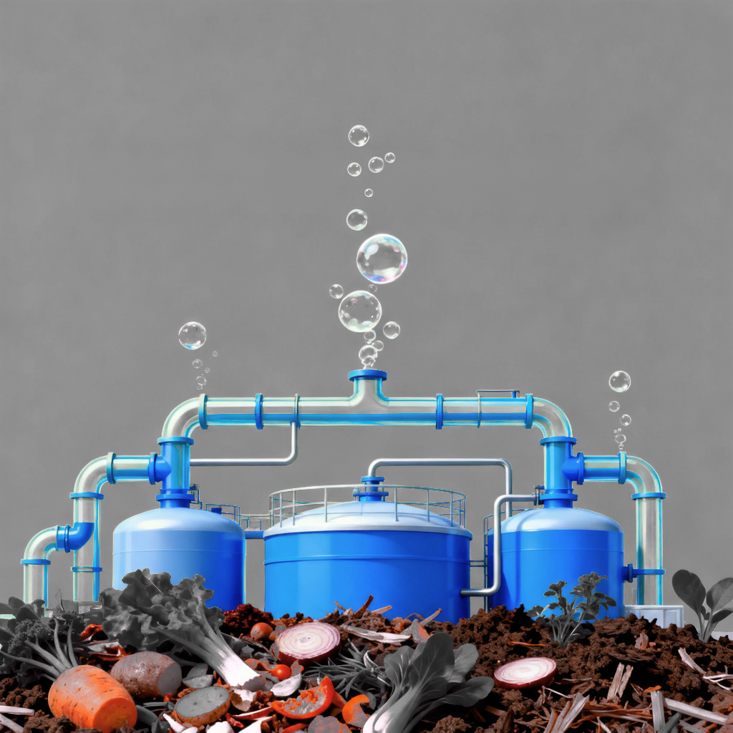


Biomass and
The Food-Water-Energy Nexus
Eureka
8.0

Slide 2

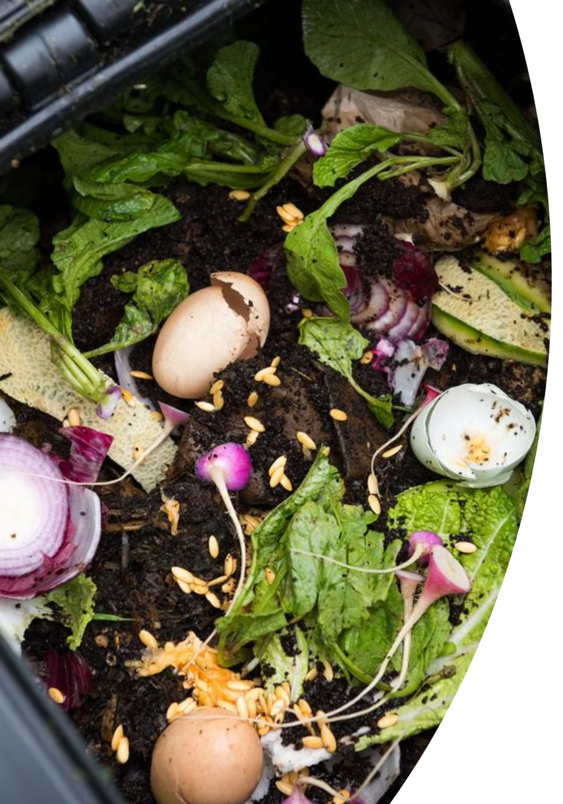
Eureka
8.0
FLUX TITANS
TEAM MEMBERS
MENTORS
SACHIN SAINI
ADITYA KULKARNI
DAKSH PARMAR
DARSHAN RABADIYA
VATSAL PRAJAPATI
MAULIK JAYANI
LALIT SINGH BIST

Slide 3
Introduction & Problem Statement
What is Biogas?
A renewable energy source produced from organic waste via anaerobic digestion.
Primarily composed of methane (CH4), it serves as a clean alternative to fossil fuels.
The Opportunity:
Restaurant waste is abundant and rich in organic matter, making it ideal for biogas production.
The Problem:
Restaurant waste has an imbalanced Carbon to Nitrogen (C/N) ratio, which is outside the optimal range of 20:1 to 30:1 for efficient digestion.
This imbalance leads to process instability and reduced methane yield.Flux-Titans-Portal-3-Report.pdf​

Slide 4
The Science of Anaerobic Digestion
Anaerobic digestion is a multi-stage biological process where microorganisms break down organic matter in the absence of oxygen.
Stage 1: Hydrolysis
Stage 2: Acidogenesis
Stage 3: Methanogenesis
Complex organic matter (carbohydrates, proteins, fats) is broken down into simpler, soluble molecules by enzymes.
Acid producing bacteria convert the simple molecules into volatile fatty acids (VFAs), acetic acid, hydrogen, and carbon dioxide.
Specialized microbes called methanogenic archaea convert the intermediate products into biogas (methane and CO2). This stage is highly sensitive to environmental conditions like pH.

Slide 5
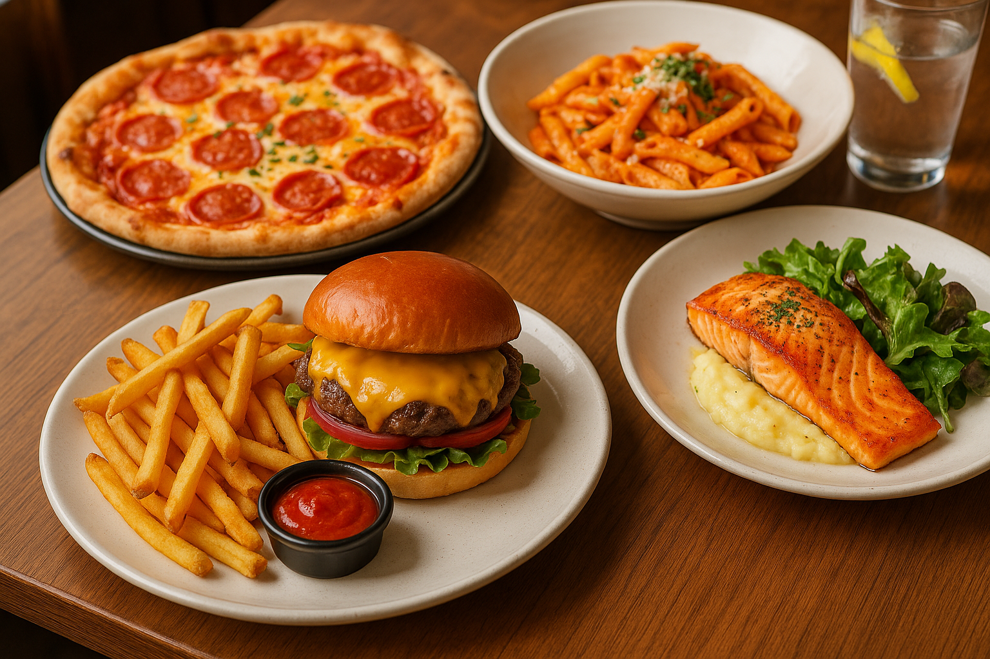
The Challenge with Restaurant Waste
The high Carbon-to-Nitrogen (C/N) ratio in restaurant waste creates significant challenges for anaerobic digestion.
Nitrogen Starvation:
Insufficient nitrogen hinders the growth and reproduction of the microbial community responsible for digestion.
Excessive VFA Accumulation:
Without a healthy microbial population, volatile fatty acids build up to toxic levels.
Process Inhibition:
The accumulation of acids causes a sharp drop in pH, which inhibits the activity of methanogens and can halt methane production entirely.

Slide 6



Solution: A Two-Part Integrated Strategy
Nutrient Balancing with Urine
Mild Acid Feedstock Pretreatment
Utilizing human urine as a natural, low-cost source of nitrogen to correct the C/N ratio and as a buffering agent to stabilize pH.
Applying a mild acid treatment to the waste before digestion to break down complex, hard to digest plant fibers

Slide 7
Strategy 1: Nutrient Balancing with Urine
Urine provides a unique, multi-functional solution to the nutrient imbalance in restaurant waste.
Natural Nitrogen Source:
Urine is rich in nitrogen (15-19 g/L), bringing the C/N ratio closer to the optimal 20-30:1 range.
Gradual Nutrient Release:
Unlike chemical additives, urine releases nitrogen slowly, providing a steady food source for microbes and preventing shock to the system.
Natural pH Buffer:
Minerals in urine help neutralize the volatile fatty acids produced during digestion, maintaining a stable pH environment essential for methanogens.

Slide 8
Strategy 2: Mild Acid Pretreatment
Pre-treating the feedstock makes the organic matter more accessible to microbes, accelerating the entire process.
Structural Disruption:
The acid breaks down tough plant cell walls (lignocellulose), exposing the energy-rich cellulose and hemicellulose fibers inside.
Increased Surface Area:
This breakdown increases the porosity and surface area available for microbial attack, leading to faster digestion.
Enhanced Solubility:
The process converts complex carbohydrates into simple sugars, providing an immediate food source for the acidogenic bacteria. Studies show this step alone can boost methane production by nearly 50%

Slide 9
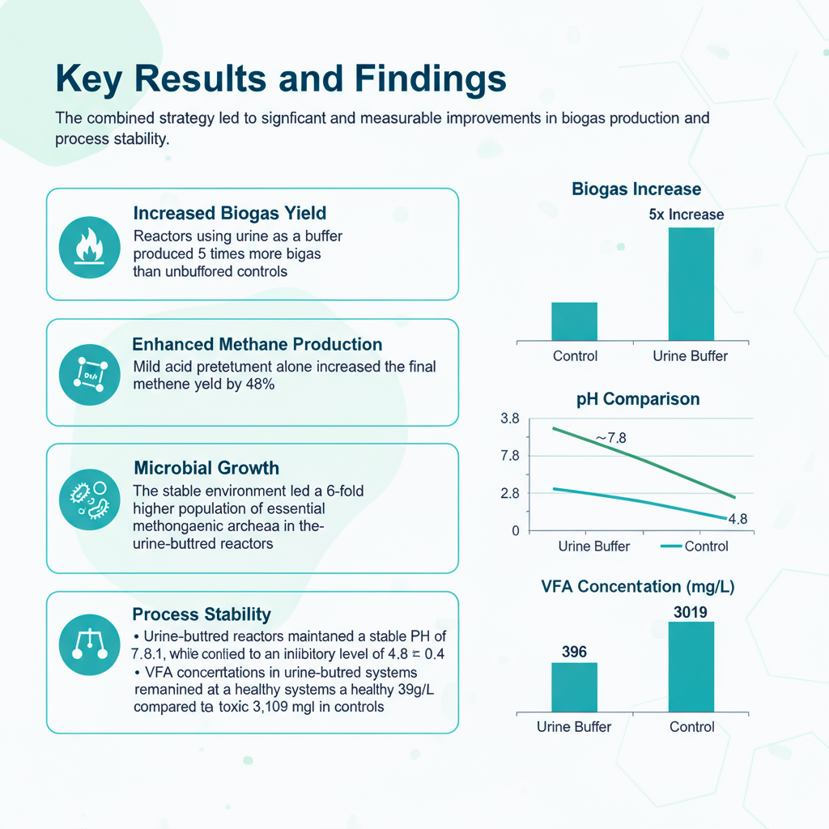

Key Results and Findings
The combined strategy led to significant and measurable improvements in biogas production and process stability.
Increased Biogas Yield:
Reactors using urine as a buffer produced 5 times more biogas than unbuffered controls.
Synergistic Effects: When combined, nutrient balancing and pretreatment resulted in even greater performance
Enhanced Methane Production: Mild acid pretreatment alone increased the final methane yield by up to 48%.
Microbial Growth: The stable environment led to a 6-fold higher population of essential methanogenic archaea in the urine-buffered reactors.
Process Stability:
Urine-buffered reactors maintained a stable pH of 7.8 ± 0.1, while control reactors acidified to an inhibitory level of 4.8 ± 0.4.
VFA concentrations in urine-buffered systems remained at a healthy 396 mg/L, compared to a toxic 3,109 mg/L in controls.

Slide 10
Environmental & Economic Benefits
This integrated approach offers a sustainable and economically viable model for waste management
Environmental Advantages:
Waste Valorization:
GHG Reduction:
Nutrient Cycling:
Diverts food waste from landfills, reducing soil and water contamination.
Captures methane, a potent greenhouse gas, and converts it into clean energy.
The digestate byproduct is a nutrient-rich bio-fertilizer, reducing the need for synthetic fertilizers.
Economic Viability:
Low-Cost Inputs:
Renewable Energy:
Circular Economy:
Uses waste materials (restaurant scraps, urine) that are free or have a negative cost (disposal fees).
Produces biogas that can be used for cooking, heating, or electricity generation, reducing energy costs.
Creates a closed-loop system where waste is transformed into valuable products, generating new revenue streams.

Slide 11
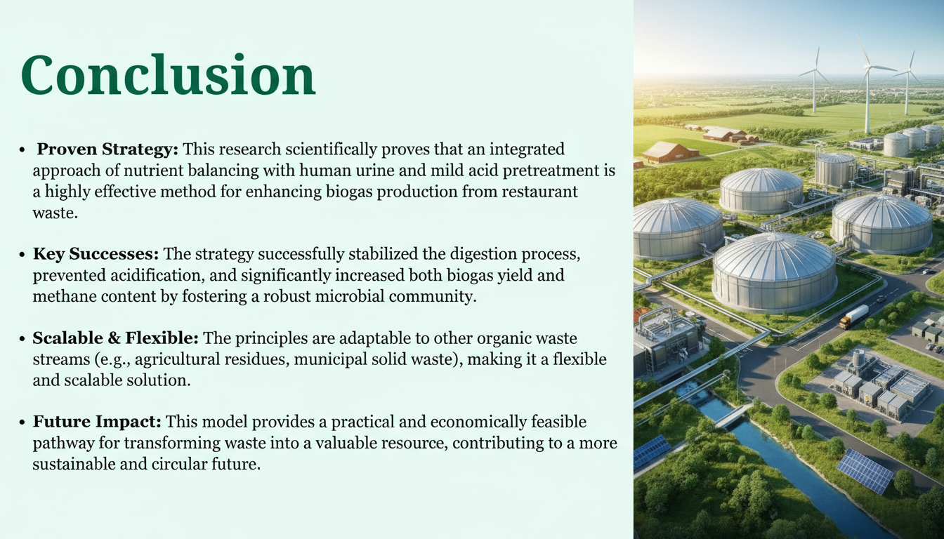
Conclusion
Proven Strategy: This research scientifically proves that an integrated approach of nutrient balancing with human urine and mild acid pretreatment is a highly effective method for enhancing biogas production from restaurant waste.
Key Successes: The strategy successfully stabilized the digestion process, prevented acidification, and significantly increased both biogas yield and methane content by fostering a robust microbial community.
Scalable & Flexible: The principles are adaptable to other organic waste streams (e.g., agricultural residues, municipal solid waste), making it a flexible and scalable solution.
Future Impact: This model provides a practical and economically feasible pathway for transforming waste into a valuable resource, contributing to a more sustainable and circular future.

Slide 12


